Slide 1
Elastic Search
Yeqing Lin

Slide 2
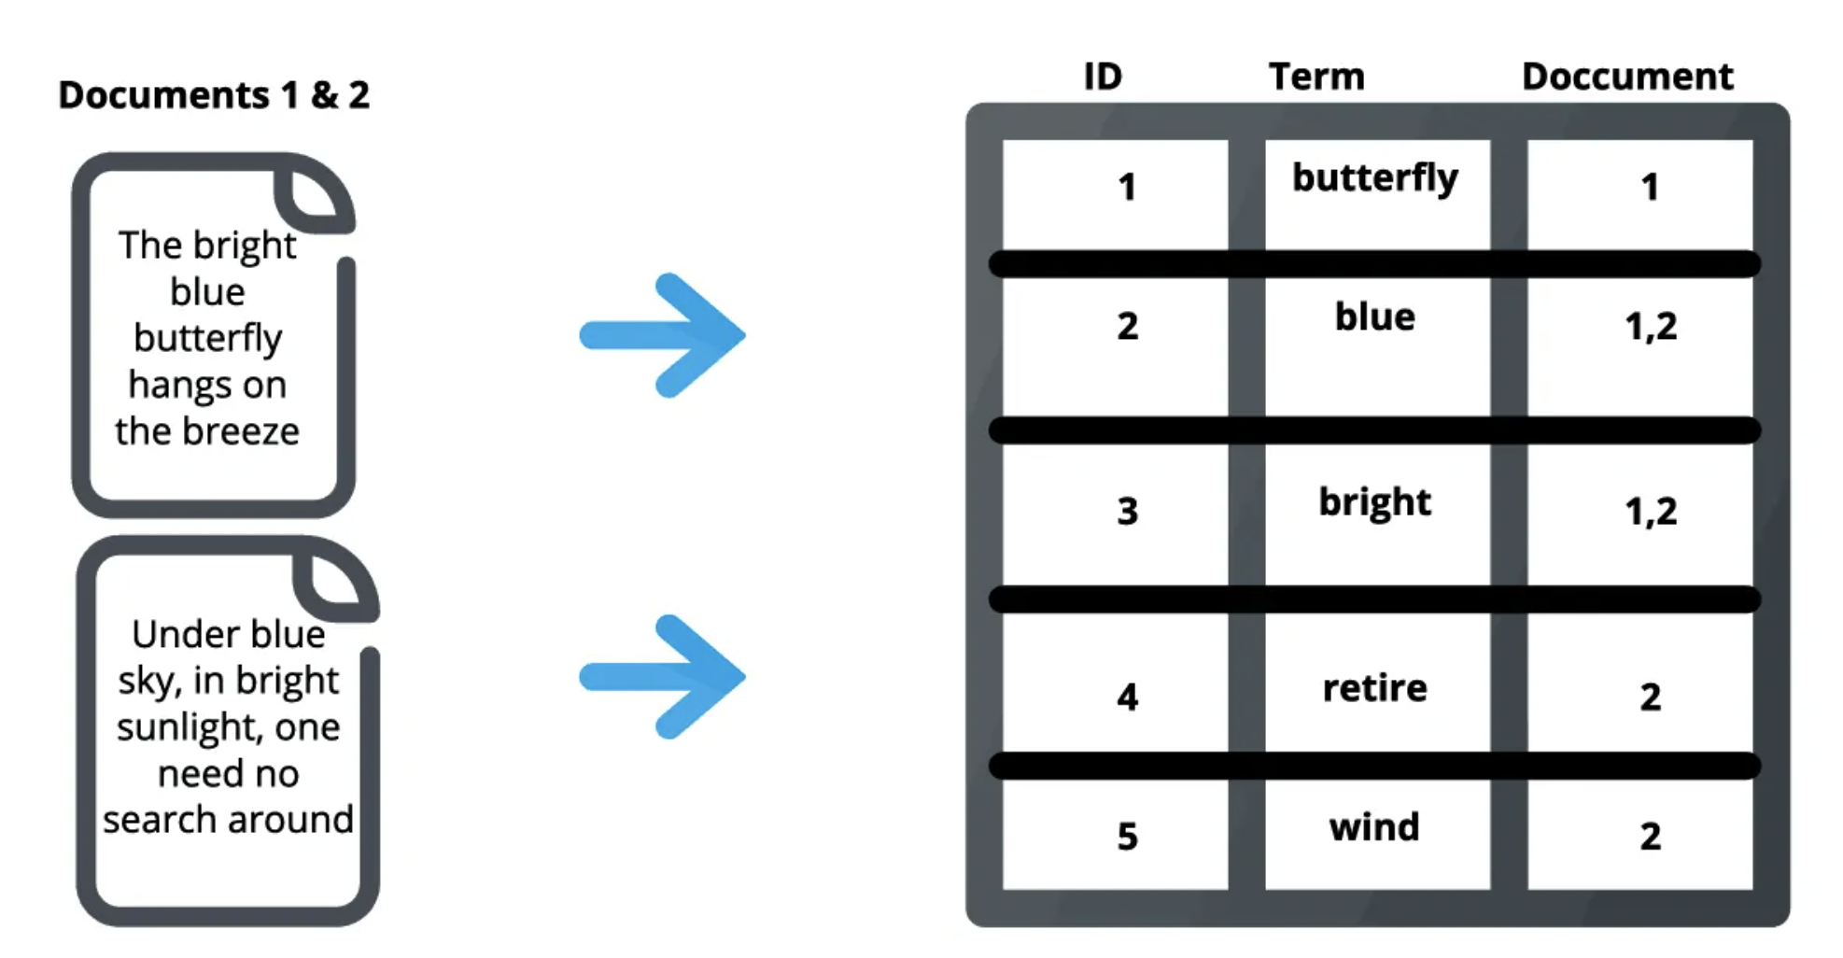
What is ElasticSearch?
Distributed, open-source search and analytics engine
Allows store, search and analyze huge volumes in near real-time
Applicable for all types of data, including textual, numerical, geospatial, structured and unstructured data
Data structure: inverted index

Slide 3
Why use ElasticSearch?
Scalability
Fast performance
Provides domain specific language based on JSON to define queries
Easily integration with Kibana (data visualization)

Slide 4
Demo
How to create an ElasticSearch instance on AWS?
How to set up an ElasticSearch instance?
How to use an ElasticSearch instance?

Slide 5
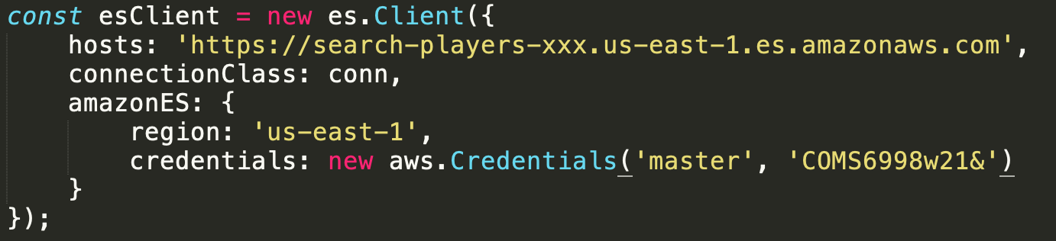

Slide 6
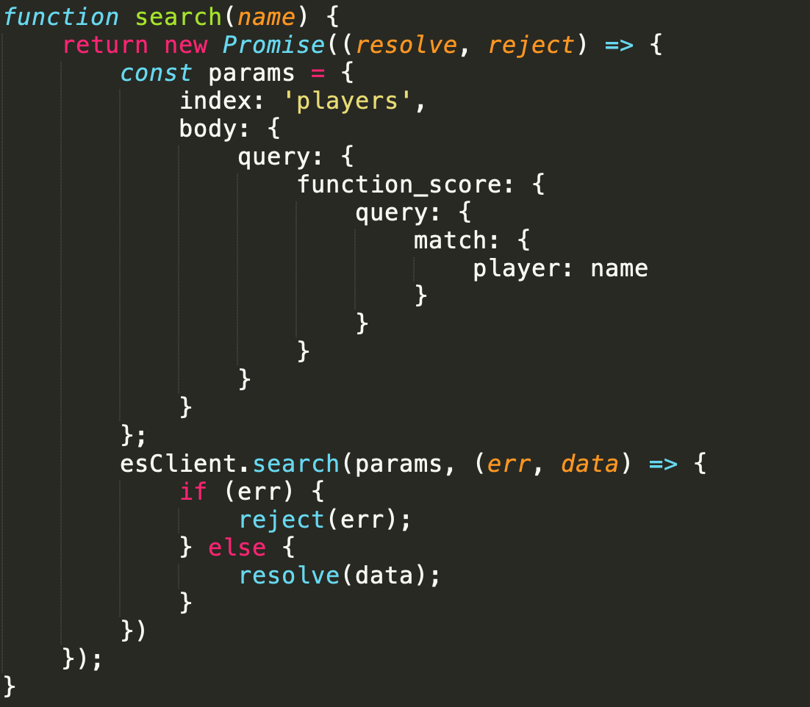

Slide 7
Important Tips
Delete ElasticSearch domain when you are not using it!!!
When running ElasticSearch on AWS Lambda function, check
- correct endpoint and access role?
- lambda role has access to elastic search?
- elastic search domain grants access?

Slide 8
References
https://medium.com/@AIMDekTech/what-is-elasticsearch-why-elasticsearch-advantages-of-elasticsearch-47b81b549f4d
https://www.knowi.com/blog/what-is-elastic-search/

